Slide 1







Slide 2
Painting the Path From Homeless to Home
SPEAKERS
Tamara Stewart, MHC
Fredrick Davis, MHC

Slide 3


From homelessness to housed
Notes:
This session will explore how effective case management, wraparound services, and intentional planning support individuals and families in transitioning from homelessness to stable housing. Participants will learn practical strategies for aligning housing assistance, supportive services, and partnerships to promote long-term housing success.
But first, let’s explore how HUD CPD programs can be used to transform your community, supportive services is the final step, but for success all steps must work together. If you are attending my next session, you will hear this again.

Slide 4


Objectives
Participants will review the three steps needed to create a path for stable housing and dive into the coordination of services, data, and housing stability:
Step 1: Identifying the need
Step 2: Creating a system to address the needs
Step 3: Data
Notes:
1. Integrate Housing and Supportive Services
Participants will be able to explain how effective case management and wraparound services contribute to housing stability and identify at least two ways to align housing operations (development and property management) with supportive service delivery.
2. Apply Coordinated Strategies for Housing Stability
Participants will be able to apply practical strategies to coordinate housing assistance, supportive services, and community partnerships to support individuals and families transitioning from homelessness to permanent housing.
3. Strengthen Cross-Sector Partnerships for Long-Term Outcomes
Participants will be able to identify key partners (e.g., service providers, housing agencies, and community stakeholders) and develop an approach for collaboration that promotes long-term housing success and reduces returns to homelessness.

Slide 5
Connecting the Pathway
CDBG
Rebuilds Communities and Creates Jobs
HOME/
HTF
Build Affordable Housing
Supportive Services
Connects People to Stability
Homeownership
Builds Generational Wealth
Stronger Community
Notes:
This session will focus on Supportive Services through community housing support and its involvement in this entire process and how it creates a path from homelessness to home.

Slide 6
Defining Homeless
Literal Homelessness: Individuals or families living in places not meant for human habitation (e.g., streets, cars), in emergency shelters, or transitional housing. This includes those exiting institutions if they were homeless immediately prior to entry and have been in the institution for up to 90 days.
Imminent Risk of Homelessness: Individuals or families who will lose their primary nighttime residence within 14 days and lack resources or support networks to obtain other housing. This includes those living in motels, doubled-up situations, or other unstable housing due to economic hardship.
Fleeing Domestic Violence or Life-Threatening Conditions: Individuals or families escaping domestic violence, sexual assault, stalking, or other dangerous situations, who have no other residence and lack resources or support networks.

Slide 7
Defining Homeless
Chronic homelessness: Being homeless for at least 12 months continuously, or on at least four separate occasions in the past three years totaling 12 months, with breaks of at least seven nights between episodes.
Individuals coming out of chronic homelessness will need more intensive services and care as they progress to housing self-sustainability.

Slide 8
Defining Homelessness
Hidden homelessness are individuals without stable, permanent housing who do not live on the streets or in shelters. They often "couch surf" with friends/family, live in cars, squat, or stay in unsafe, temporary, or overcrowded conditions.
Notes:
making them invisible to official counts

Slide 9
Step 1: Determine the Need

Slide 10
Step 1: Determine the Need
Population | Total | Sheltered | Unsheltered | Other Unhoused | Region
Overall | 1058 | 354 | 214 | 490 | Statewide
Individuals | 213 | 13 | 83 | 117 | North MS
 | 63 | 6 | 11 | 46 | Central MS
 | 176 | 2 | 86 | 88 | South MS
Families | 18 | 2 | 4 | 12 | North MS
 | 19 | 2 | 7 | 10 | Central MS
 | 43 | 3 | 17 | 23 | South MS
MAOI | 142 | 121 |  | 21 | North MS
 | 268 | 139 |  | 129 | Central MS
 | 106 | 65 |  | 41 | South MS
Veterans | 3 | 1 | 2 | 0 | North MS
 | 3 | 0 | 0 | 3 | Central MS
 | 4 | 0 | 4 | 0 | South MS

Slide 11

Intersection of Health and Homelessness

Slide 12

Affordable Housing and Health
Housing Cost Burden Linked to Worse Health
Increased rent burden linked to increased mortality rates
Evictions linked to increased mortality rates
Rental and Housing Assistance Programs Linked to Improved Health
Notes:
Rent burden that increased from a baseline of 30% to 50%, = increase in mortality by 9%
Rent burden that increased from a baseline of 30% to 70%, = increase in mortality by 12%
Filing evictions linked to increase in mortality of 19% and eviction judgments were associated to an increase mortality 27%

Slide 14

The Cost of Homelessness

Slide 15
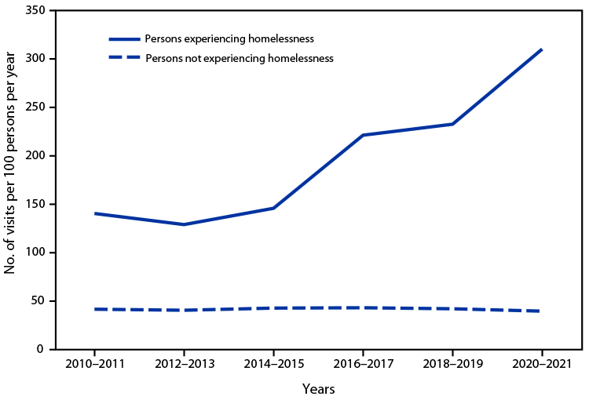
Emergency Room Visits
Notes:
CDC: The rate of visits to hospital emergency departments by persons experiencing homelessness increased from an estimated 141 visits per 100 persons per year during 2010–2011 to 310 during 2020–2021. Rates increased during 2016–2017 compared with 2014–2015, and again during 2020–2021 compared with 2018–2019.
Visit rates for persons not experiencing homelessness did not vary significantly across years, ranging from 42 visits per 100 persons per year during 2010–2011 to 40 during 2020–2021. Visit rates for persons experiencing homelessness were higher than rates for persons not experiencing homelessness in all years.

Slide 16
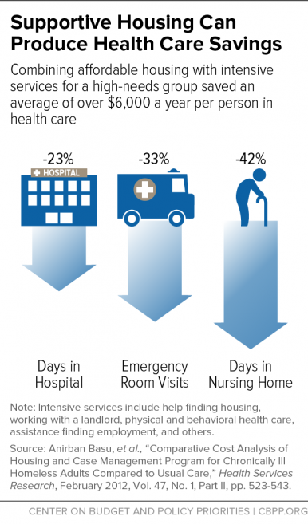
Supportive Housing can reduce the cost of health services and the need for emergency care
Notes:
Homelessness And Health: Factors, Evidence, Innovations That Work, And Policy Recommendations | Health Affairs
Homelessness And Health: Factors, Evidence, Innovations That Work, And Policy Recommendations

Slide 17
The Cost of Homelessness
Based on 2024 data, Mississippi has approximately 982 homeless individuals.
The financial cost to taxpayers for managing this population—including emergency room visits, law enforcement, and shelter services—is estimated to be averaging around $2,000–$35,000 per person annually depending on chronic status.
  $23,568,000 to $412,440,000 annually.

Slide 18
The Cost of Homelessness in MS
Homelessness in Mississippi, while lower than the national average, impacts about 1,000 individuals statewide.
It creates a high financial burden driven by housing shortages, with 50.3% of renters in 2024 considered cost-burdened. This instability forces nearly 49% of households into financial hardship—below the Federal Poverty Level, which pushes them to evictions and homelessness.
Notes:
ALICE
Public Cost Impact: Studies suggest that for each chronically homeless person, taxpayers can pay an average of
per year, making the financial burden for this population significant.
Healthcare/Service Costs: Research indicates an average excess cost of about
per person for treating homeless individuals, primarily through emergency medical services.
Funding and Support: Mississippi has received funding, such as over
million from the U.S. Department of Housing and Urban Development (HUD) to support housing for people experiencing homelessness.
Shelter Rate: In Mississippi, only about
of the homeless population is in shelters, which is relatively low compared to other states.

Slide 19
Housing program financial benefits
Placing a homeless individual in a rapid re-housing program generally costs taxpayers between $4,100 and $8,486 per household annually.
Some studies indicate the average cost per exit to permanent housing for rapid re-housing is roughly $4,100.
The annual cost for housing homeless individuals in MS:
  $1,100 per household
  The projected cost of rent and support is $2,000 per household.

Slide 20
Step 2: Strategic Planning a Systematic Approach

Slide 21
Step 2: Strategic Planning and Goals
Mississippi Home Corporation (MHC) has identified the state needs and developed goals for the next 5 years to strategically address the needs.
Goal 1: HOME Rental Development. Expand and Preserve Affordable Rental Housing
Goal 2 HOME, ESG & HOPWA. Link Housing Development with Employment & Supportive Services that promotes Self-Sufficiency

Slide 22

Systematic Approach

Slide 23




Systematic Approach: 4 Key Areas
Outreach and Engagement
Access to Affordable Housing
Case Management and Supportive Services
Long-Term Community Support

Slide 24
How to access the programs?
Outreach
Referrals (CES/MHC)
Call/Walk-In
Resources

Slide 25
Engagement, Assessment, & Diversion
Engagement is the critical first step in connecting individuals and families experiencing homelessness to housing opportunities and supportive services.
Assessment helps determine the need and connection to the most appropriate housing intervention based on their needs.
Diversion focuses on redirecting individuals away from entering the homeless system by identifying immediate, alternative housing options.

Slide 26
Outreach and Engagement
What is “outreach and engagement”?
Seeking out people who are homeless rather than waiting for the person to come to you for resources.
Engaging identified homeless individuals in a plan that will help them exit homelessness and move into permanent housing.
Collecting appropriate data and information so that services are targeted and tracked.
Who does “outreach and engagement”?
Community agencies
Continuum of Cares
Local churches
Other community groups and organizations: Fraternity/Sorority, MEMA/FEMA

Slide 27
Outreach and Engagement: MHC
All 4 of MHC’s Supportive Services programs support outreach and engagement activities; however, each program targets outreach to a different population based on that program eligibility requirements.
  ESG: Street Outreach targeted to unsheltered homeless individuals.
  HOME-ARP: Outreach targeted to all four of the qualifying populations.
  CHOICE: Outreach targeted to individuals with a serious mental illness.
  HOPWA: Outreach targeted to individuals diagnosed with HIV/AIDS.

Slide 28
Outreach and Engagement: ESG
Street Outreach: designed to provide essential services to unsheltered homeless individuals and families. It focuses on building relationships and engaging those living in places not meant for human habitation—such as parks, abandoned buildings, or campgrounds—to connect them with emergency shelter, housing, or critical health services.

Slide 29
Outreach and Engagement: ESG
Beyond outreach and engagement, ESG also provides:
  Case management
  Essential needs
  Outpatient Health Services
  Transportation
  Outpatient Mental Health Services
  Engagement (crisis counseling; urgent physical needs, such as providing meals, blankets, clothes, or toiletries; and actively connecting to programs)
Notes:
ESG Street outreach goes beyond outreach and engagement but addresses the basic needs and attempts to identify barriers to housing and housing stability.

Slide 30
Intentional Outreach: ESG
Resources available through outreach allows for outreach to be targeted and purposeful and allows unhoused individuals to gain access to support, case management and housing.

Slide 31
Outreach & Market Studies
Outreach Data
Market Study Data
Direct surveys conducted statewide that collect relevant housing information:
  Location
  Household demographics
  Current living situation
  Household income
  Disabling conditions
  Housing history
HUD databases
Public Records
Specialized Data Services
Census Data
Household Income Size and Tenure Analysis (HISTA) builds on census data
Caritas/Nielsen: provides 5 year projections based on the American Community Survey (ACS) report
*the last Census data was from 2020-2024
Notes:
Does your market analysis reflect the community needs?

Slide 32
Hitting or Missing the Mark
If you have a preference for Special populations, is your current marketing efforts able to provide current detailed information on that population’s housing needs?
Or is that population lost in the general statistics of the community?
Notes:
If you have a preference for Special populations, is your current marketing efforts able to provide current detailed information on that population housing needs?
Or is that population lost in the general statistics of the community?

Slide 33
Special Populations MAOI and Vets

Slide 34

Access to Affordable Housing

Slide 35
Affordable Housing Shortage
Rising cost
Loss of existing affordable units
Unit size
Location and accessibility

Slide 36
Affordable Housing Shortage
In Mississippi, only 62 rental homes are affordable and available for every 100 extremely low-income households.
Mississippi needs to make 38,000 more homes affordable for extremely low-income households by expanding access to rental assistance and building deeply affordable rental homes.

Slide 37
Housing Solutions: Increase The Affordable Housing Stock
Deeper Target units
MAOI units
Low-Income Housing Tax Credit
HOME and HTF
Manufactured housing
Building where there is greatest need

Slide 38
Housing Solutions: Housing Preservation
Community Land Trusts (CLTs) for affordable permanent affordability.
Rehab of distressed properties.
Converting hotels/offices to residential (Adaptive Reuse).

Slide 39
Housing Solutions: Navigating the Shortage as a Case Manager
  Managing client expectations in a low-vacancy market.
  Developing relationships with private landlords who have affordable units.
  Creative housing options (shared housing, finding rooms for rent).

Slide 40
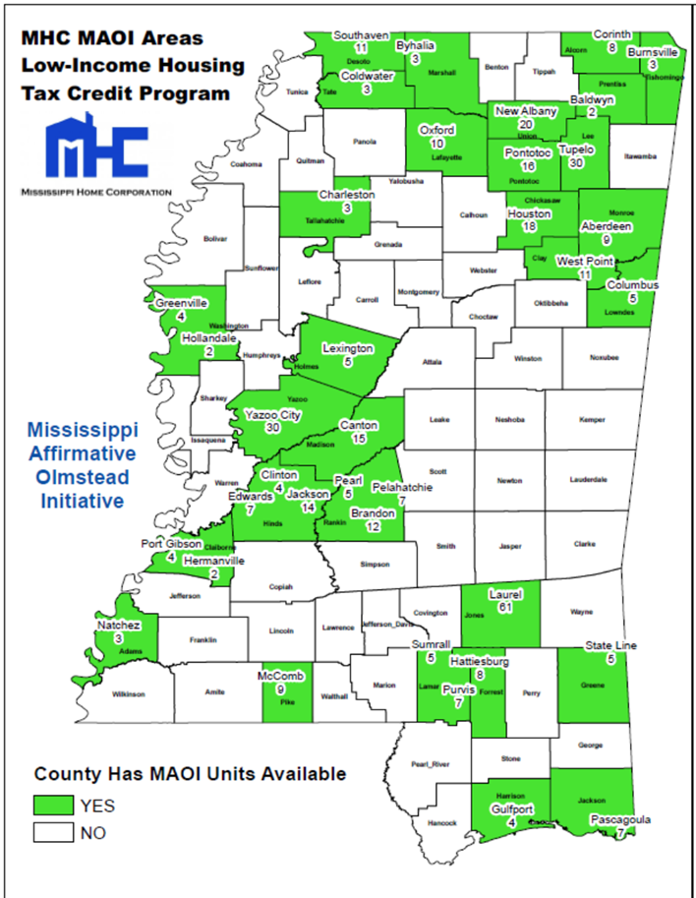
Affordable Housing in the Community vs. Need

Slide 41
Potential Barriers to Housing Placement
  Landlord discrimination
  Lack of affordable housing
  Lack of housing that is accessible to resources (food supply, employment, support network)
  Applicant and case manager flexibility
  Applicant barriers

Slide 42
Housing Search & Placement
The Case Manager should coordinate activities with housing specialist.
  To minimize client confusion, the housing specialist and case manager should clarify their roles to the client. The housing specialist should be the primary service provider until the client has successfully moved into their new home. However, the case manager should meet with the client ASAP to identify barriers, meet with the client immediately after their enrollment in rapid rehousing, and begin the assessment and resource connection process.
Housing Specialist
  The Housing Specialist/Case Manager should locate housing that meets client needs, is affordable, and is accessible to services and supports. The client’s new housing location will influence both the client's needs and access to services and supports and will influence the direction of the service plan.
  If the individual is placed in program (ESG RRH or HP), HUD requires that the individual move into permanent housing (with a move-in date) within 30 days.

Slide 43
Affordable Housing Access
What programs do you have access to?
Based on your screening questions, would the applicant fit the requirements for the programs that are available?
What are the required documentation for the program?
What eligibility documentation can you obtain immediately?
What eligibility documentation requires time to obtain?

Slide 44
Case Management and Supportive Services

Slide 45
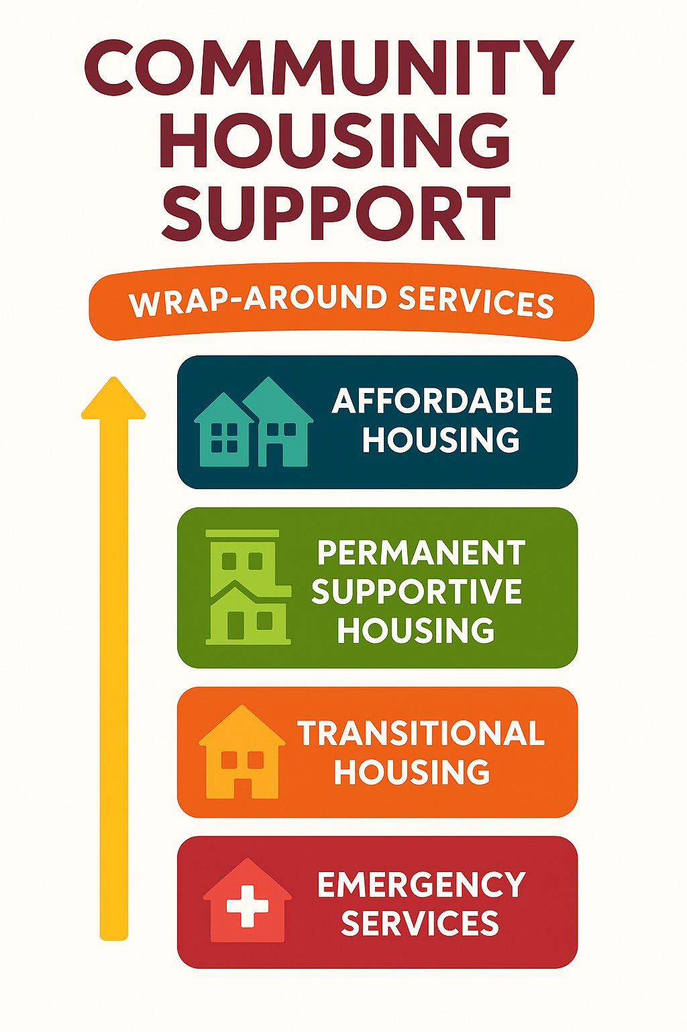
Supportive Services are provided in a multilevel systematic approach to increase housing stability.
Notes:
Each community and its resources are different; however, the main resources available in each state are Emergency Services, Transitional Housing, Permanent Supportive Housing, Affordable, Housing.

Slide 46
Case Management: Key for Housing Stability
Assessment & Goal Setting: Evaluating client needs to identify strengths and barriers to success, creating a customized plan.
Supportive Services Coordination: Linking individuals to essential services such as mental health care, job training, and financial assistance.
Preventing Eviction: Providing support to help clients pay rent on time, manage finances, and adhere to lease terms.
Housing Search Assistance: Assisting with locating housing and building relationships with landlords.

Slide 47
Case Management and MHC Supportive Services Programs
All 4 of MHC’s Supportive Services programs support case management activities and rental assistance; however, each program may have different types of services that can be layered with case management.
Programs include:
  Emergency Solutions Grant
  CHOICE
  HOME-ARP
  HOPWA

Slide 48
Case Management: Key for Housing Stability
Is an aggressive service required with most housing assistance programs that has specific requirements to maximize resources:
  A face-to-face engagement at minimum of once a month.
    More frequently depending on the needs identified during assessment.
  A service plan with obtainable goals that all lead to housing self-sustainability.
    Each goal is time-sensitive and addresses identified barriers to obtaining housing stability. Goals are flexible and can be adjusted as needed based on continued evaluation.
  Provides a partner to help navigate the applicant and be a liaison between landlords, service providers and the client.

Slide 49
Case Management & Supportive Services:
Key for Housing Stability
Supportive Services is a layer that is added to case management to provide a stability boost.
There are two types of Supportive Services:
Housing financial assistance
Client Essential Services

Slide 50
Case Management & Supportive Services:
Key for Housing Stability
Housing Financial Assistance: pays for housing and housing related costs.
  Move-in costs: rental and utility deposits, application fees, storage fees needed for relocation up to 30 days.
  Rental arrears: up to 6 months in arrears.
  Utility arrears: up to 6 months in arrears.
  Rental assistance: up to 24 months based on the program and available resources (HOME-ARP and HOPWA TBRA may be longer).
  Utility assistance: up to 24 months based on the program and available resources (HOME-ARP and HOPWA TBRA may be longer).
  Unit damages is allowed under CHOICE up to an identified cap.

Slide 51
Case Management & Supportive Services:
Key for Housing Stability
Client Essential Services : pays for the wraparound services not provided in the community that are needed to increase stability.
  Education services
  Job training and employment services
  Outpatient mental health and health services
  Budgeting and Credit Counseling
  Life skills
  Legal services- related to housing stability
  Mediation

Slide 52

Long-Term Community Support

Slide 53
Engaging Support with Affordable Housing
Identify Partners: Non-profits, faith-based groups, and healthcare sectors.
  MHC has set the framework for successful community agency partnerships though MOUs and LOCs.
  Be flexible! Let “lessons learned” grow you not stop you.
Community Advocacy: Educating neighbors to overcome "NIMBY" (Not In My Back Yard) opposition.
  Mixed use properties
  Partner with agencies that provide case management.

Slide 54
The Ecosystem of Care
What is available in the community?
  CoC: The CoC programs (such as the Central MS CoC and Balance of State) focus on addressing homelessness and housing stability. The CoC provides permanent supportive housing (PSH), rapid re-housing, and supportive services.
  DHS: MDHS provides financial and community support for low-income individuals, families, and seniors. The DHS provides multiple benefits including SNAP, TANF, childcare, LIHEAP, and services for the aging.
  State: Services provided through MHC.
  DMH: DMH provides community-based services through certified regional community mental health centers (CMHCs) and other local nonprofits.
  Foster care

Slide 55
Step 3: Measurable Performance

Slide 56
Expected Outcomes
By implementing coordinated engagement, assessment, diversion, and housing strategies, participants can expect improved system performance and stronger client outcomes across the housing continuum.
Increased Access to Housing: More individuals and families are successfully connected to appropriate housing interventions (prevention, rapid rehousing, permanent supportive housing).
Reduced Length of Time Homeless: Households move more quickly from homelessness to permanent housing due to coordinated entry, streamlined assessments, and strong partnerships.
Improved Housing Stability: A higher percentage of households remain stably housed at 3, 6, and 12 months as a result of effective case management and wraparound services.
Decreased Returns to Homelessness: Fewer households re-enter the homeless system due to intentional planning, follow-up services, and sustained support.
Increased Income and Self-Sufficiency: Households experience income growth through employment, benefits access, and supportive services coordination.
More Effective Use of Resources: Diversion and targeted interventions reduce unnecessary shelter stays and ensure resources are used efficiently.
Strengthened Cross-Sector Partnerships: Improved collaboration between developers, property managers, and service providers leads to better placement outcomes and long-term success.

Slide 57
Step 3: Measurable Performance Indicators (HUD-Aligned) 2025
Total number of households housed = 520
  Unsheltered housed= 168
Total number of households with increased income = 133
Average length of time from engagement to housing placement =28 day

Slide 58
Key Takeaways From Presentation:

Slide 59
Key Takeaways for Presentation:
Affordable Housing is a Social Determinant of Health: It directly impacts education, safety, and economic stability.
Integrated Supports are Critical: Supportive services prevent evictions and improve quality of life for vulnerable populations.
Collaboration is Mandatory: Success requires partnering with healthcare, non-profits, and government entities.

Slide 60
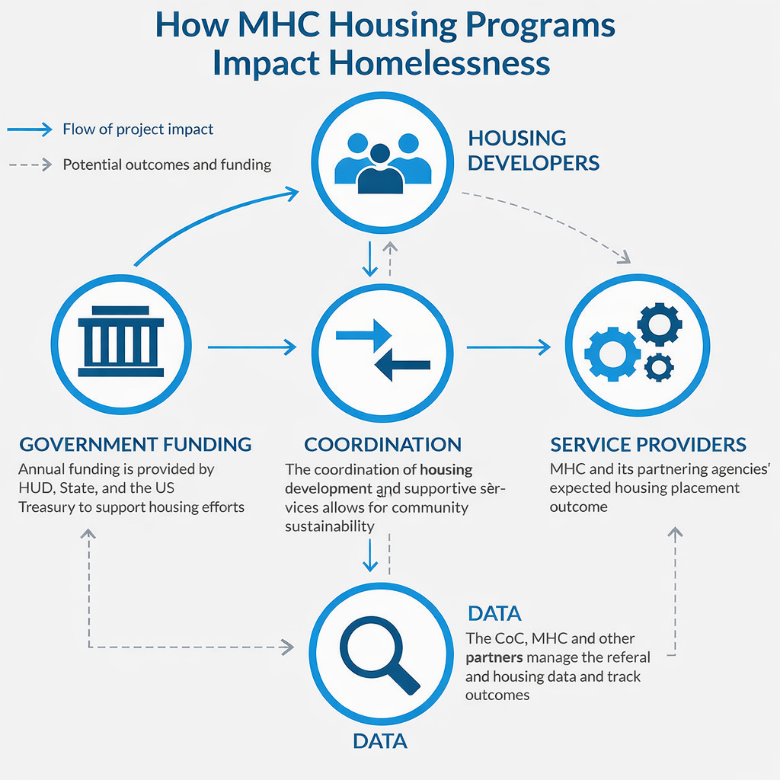

Slide 61
QUESTIONS

Slide 62

Contact information:
Tamara Stewart
VP of Federal Grants Management
Tamara.Stewart@mshc.com
601-718-4654
Fredrick Davis
AVP of Federal Grants Management
fredrick.davis@mshc.com
601-718-4657

